Slide 1



THE CAR RENTAL AUTOMATION

Slide 2
INTRODUCTION
This project is a comprehensive automation solution designed to optimize business operations and improve efficiency. It simplifies key processes, enhances resource management, and provides valuable insights through data-driven reports. Built with a robust and scalable technology stack, it ensures seamless performance, reliability, and a user-friendly experience, empowering businesses to deliver better services and make informed decisions.

Slide 3
Overview:
CarCaddy is a next-generation car rental automation system designed to enhance operational efficiency, ensure vehicle availability, and deliver an exceptional customer experience. By integrating advanced booking, fleet management, and data-driven reporting, it minimizes manual workload and maximizes productivity.
Effortless Rental Management- Streamlines bookings, modifications, and cancellations with accurate fare calculations.
Intelligent Fleet Tracking – Keeps real-time records of vehicle availability, maintances, service alerts.
Customer- Centric Approach – Enhance user experience with a loyalty program and a streamlined booking process.

Slide 4
Objective:
✔ Efficiency, Automation & Customer Satisfaction
✔ Seamless Booking & Management - Eliminate inefficiencies in reservations, cancellations, and fare calculations.
✔ Optimized Fleet Performance - Automate maintenance scheduling and improve vehicle utilization.
✔ Data-Backed Decision Making - Leverage smart analytics to drive growth and maximize revenue.
✔ Enhanced Customer Experience - Personalize services with loyalty rewards and a hassle-free rental process.
CarCaddy isn't just a system—it's a game-changer in car rental automation, built to deliver reliability, profitability, and customer delight.

Slide 5
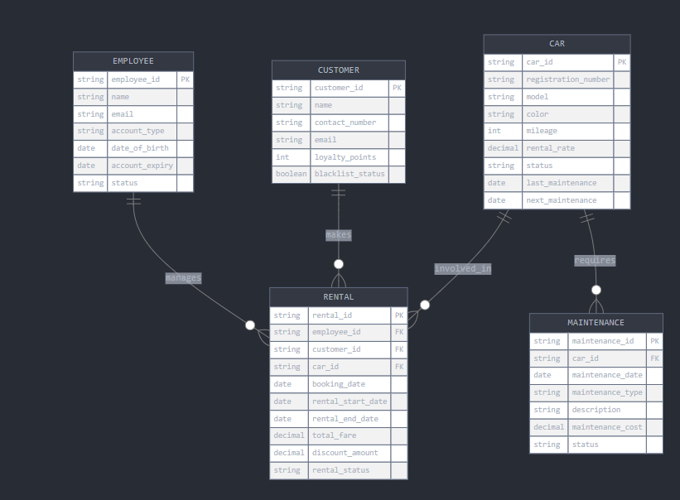
ER-Diagram:

Slide 6
TECHNOLOGY STACK
Java
Thymleaf
Hibernate
Javascript
Spring
MySQL

Slide 7
Employee Management:
The Employment Management Module handles employee accounts, including registration, login, and lifecycle, ensuring secure access and proper account handling.
Features:
Employee Registration & Login with Session Handling:
Employees can register and log in, with secure session handling to ensure protected access to their accounts. Once logged in, the session persists, allowing continuous access during the user’s active session.
2. Fetching Employee Details:
After login, the system retrieves all employee details from the database for user management. This information is then displayed on the frontend for easy access and administration.

Slide 8
3. Admin Deactivation & Management:
Admins can deactivate or manage employees based on their resignation or contract expiration, updating their status accordingly. This ensures that only active employees have access while inactive ones are properly handled.
4. Email Notifications:
When an employee’s account is deactivated due to resignation or expiration, an email notification is sent to both the employee and the admin. This ensures both parties are promptly informed of the status change.
5. Exception Handling :
The system handles exceptions like Admin Already Exists, Admin/Employee Not Found, Invalid Entity, and Password Not Found to manage registration and login errors. A Global Exception Handler ensures standardized error responses for all unhandled exceptions.

Slide 9
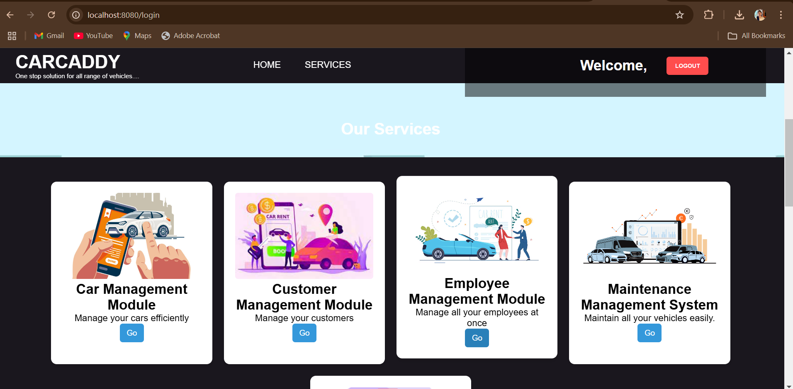
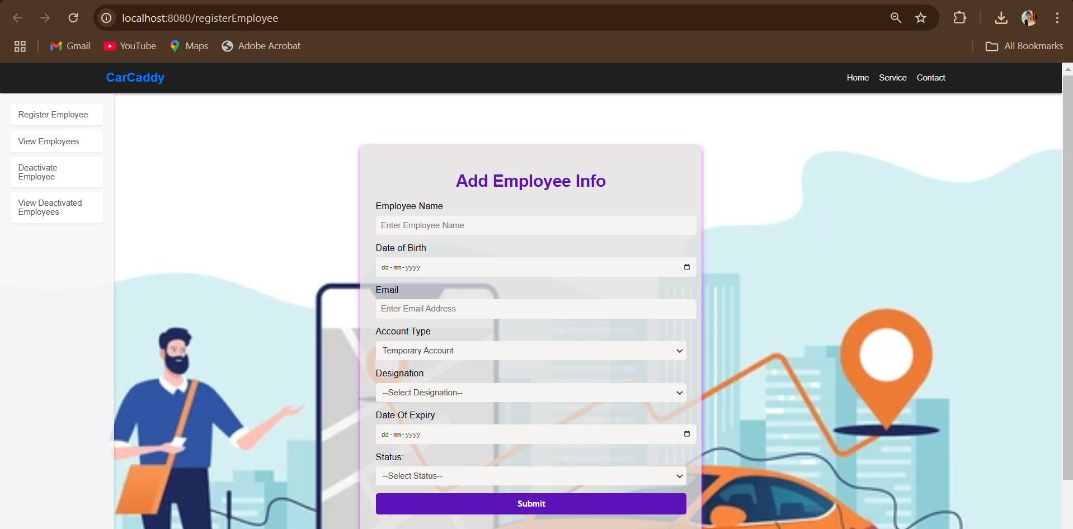
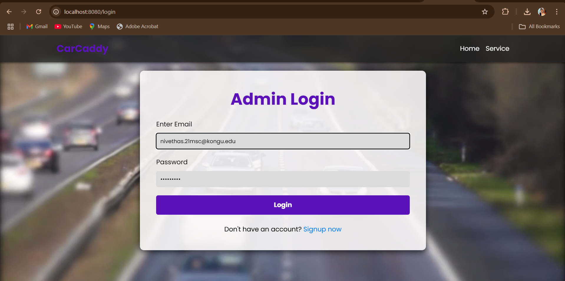
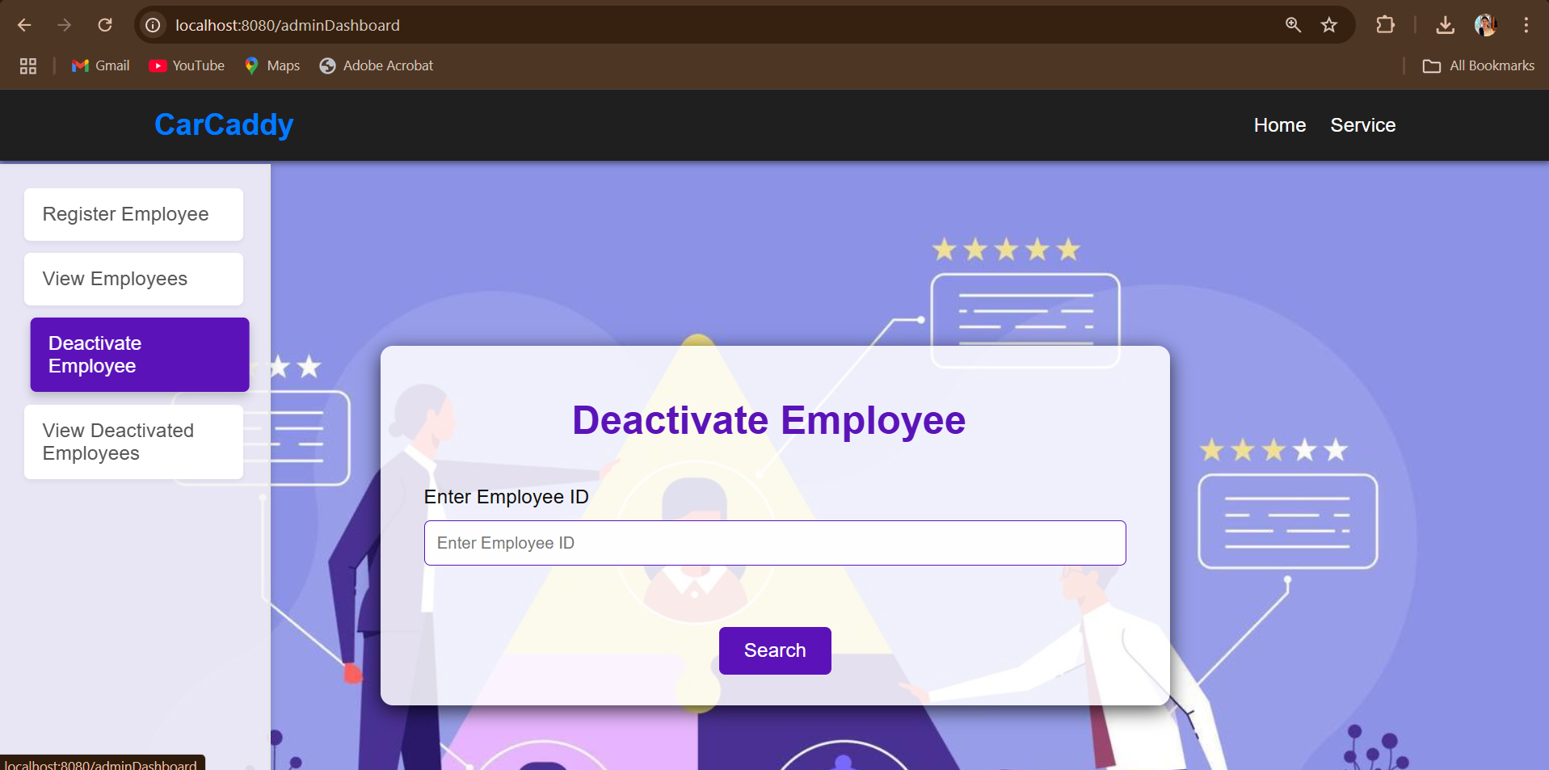
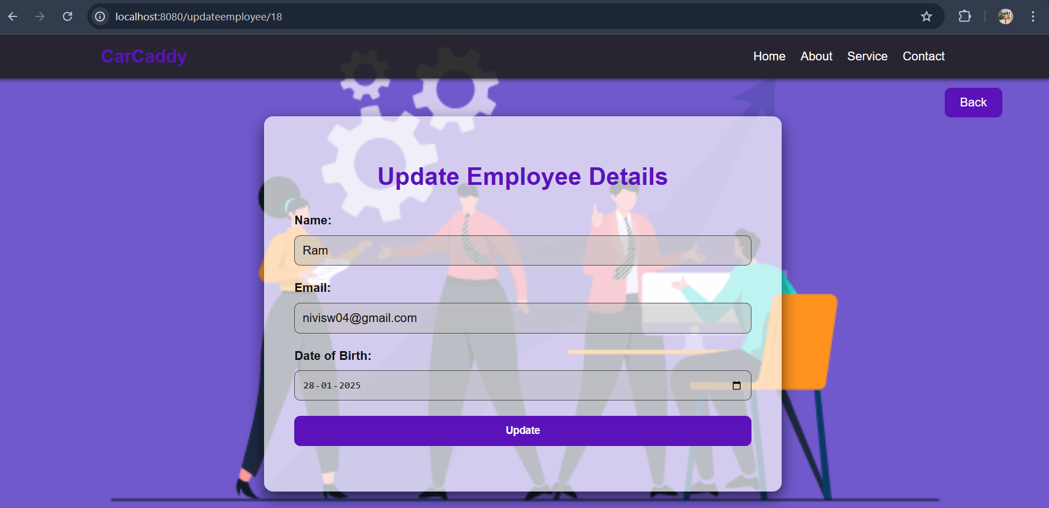
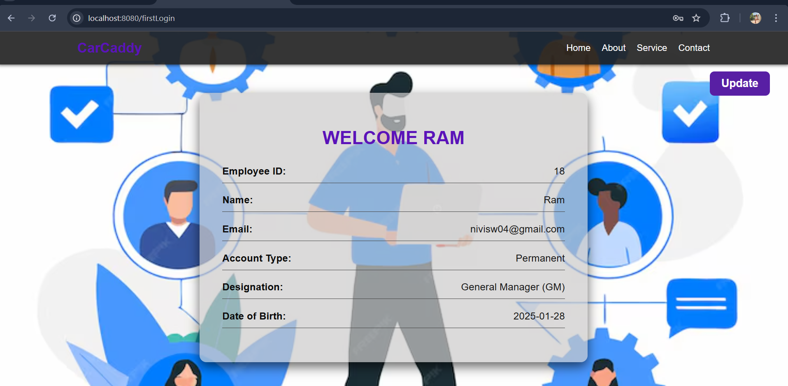
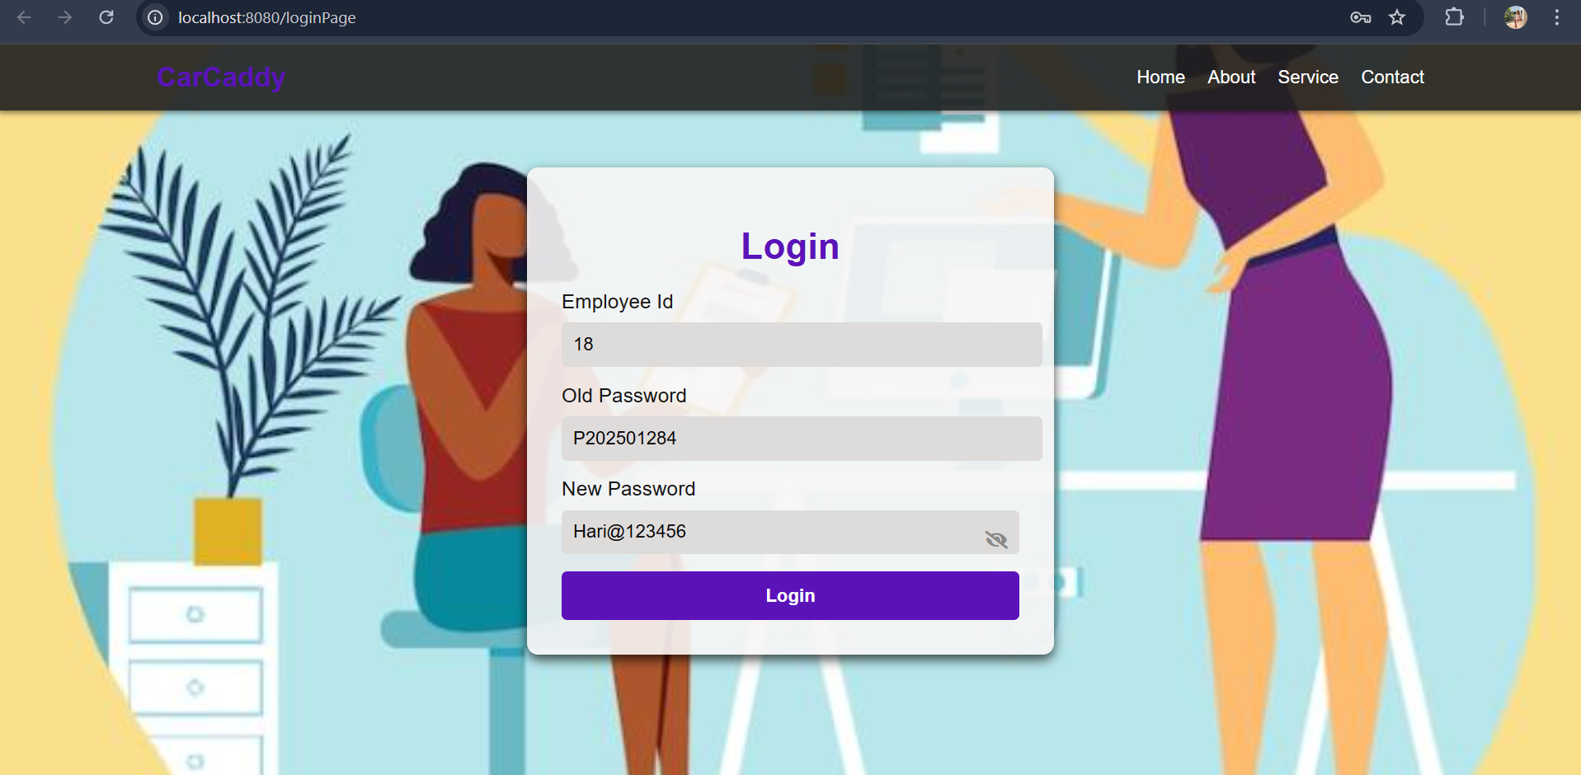
EMPLOYEE MANAGEMENT

Slide 10
Car Management
The Car Management Module ensures seamless rental operations, helping businesses efficiently manage their fleet, track car status, and automate maintenance.
Key Features
1. Add & Update Car Details:
Empower receptionists to efficiently manage vehicle inventory by adding new car records and updating existing details, ensuring data accuracy and accessibility.
2. View & Filter Cars:
Quickly locate vehicles based on status and type, with robust filtering capabilities. The system intelligently handles valid and invalid cases, ensuring seamless search functionality.

Slide 11
3. Maintenance & Alerts:
Proactively maintain your fleet with automated service recommendations based on usage. Comprehensive maintenance logs provide a detailed history for each vehicle.
4. Deletion & Status Updates:
Maintain accurate records by removing obsolete car entries. Easily track maintenance progress with status updates, ensuring efficient workflow management.

Slide 12
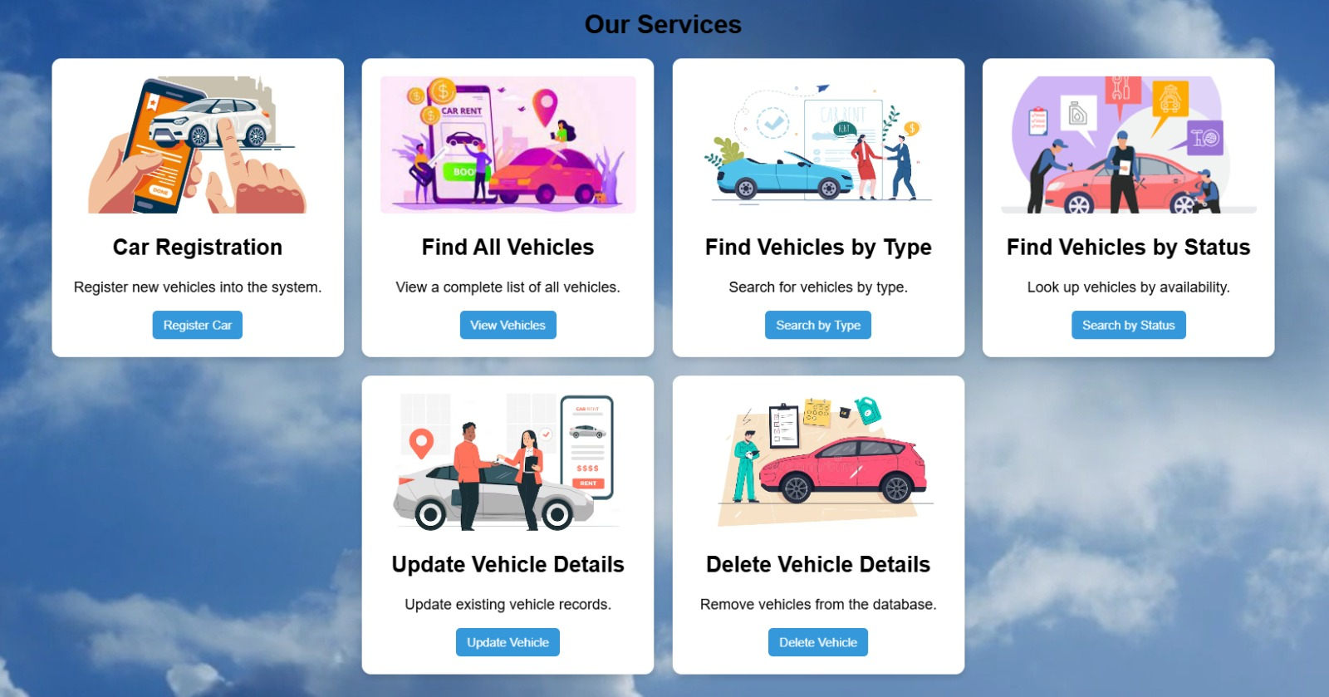
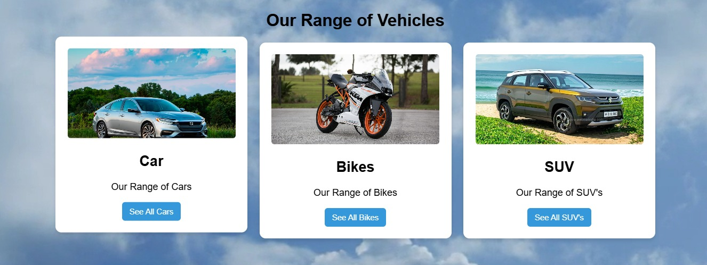
💡
From hassle-free bookings to real-time vehicle tracking, our advanced rental system streamlines every step. Manage reservations, update vehicle details, and access reports effortlessly.
💡
Explore our wide selection of cars, bikes, and SUVs, designed to meet all your travel needs. Whether for daily commutes or adventurous road trips, we have the perfect ride for you.

Slide 13
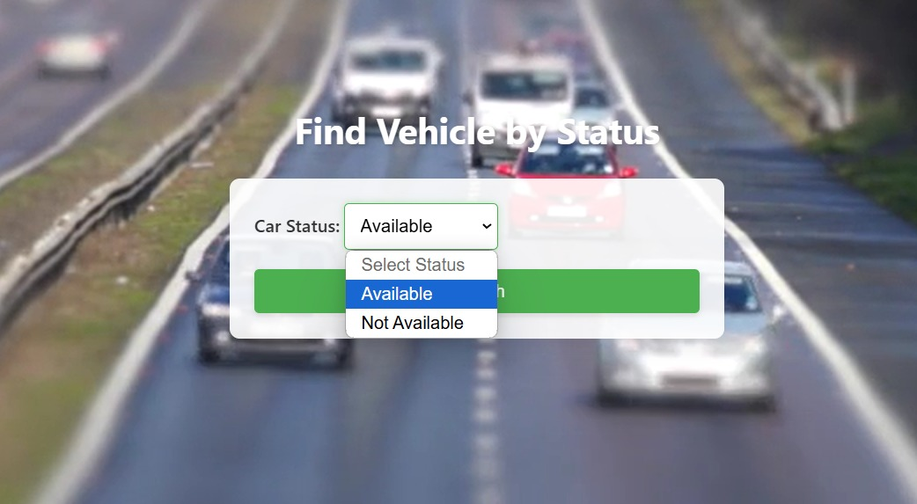
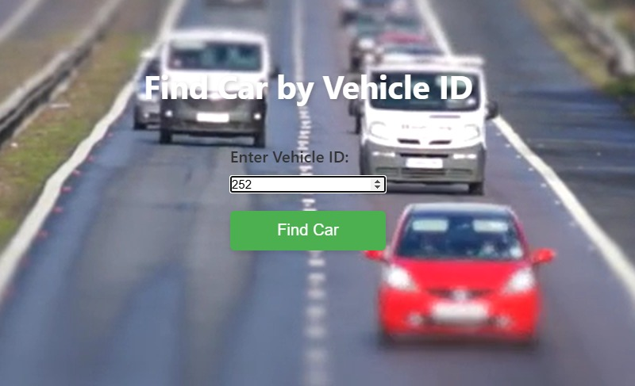
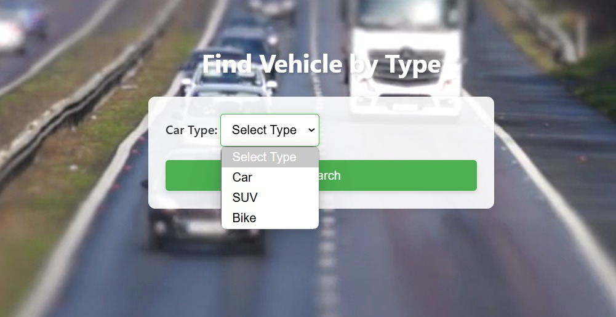
Find Vehicle by Status:
Quickly filter vehicles based on availability, ensuring efficient fleet utilization and seamless customer service.
Find Vehicle by ID:
Instantly retrieve detailed vehicle information using a unique ID, streamlining management and tracking.
Find Vehicle by Type:
Easily categorize and locate vehicles based on type, optimizing rental selection and fleet organization.

Slide 14
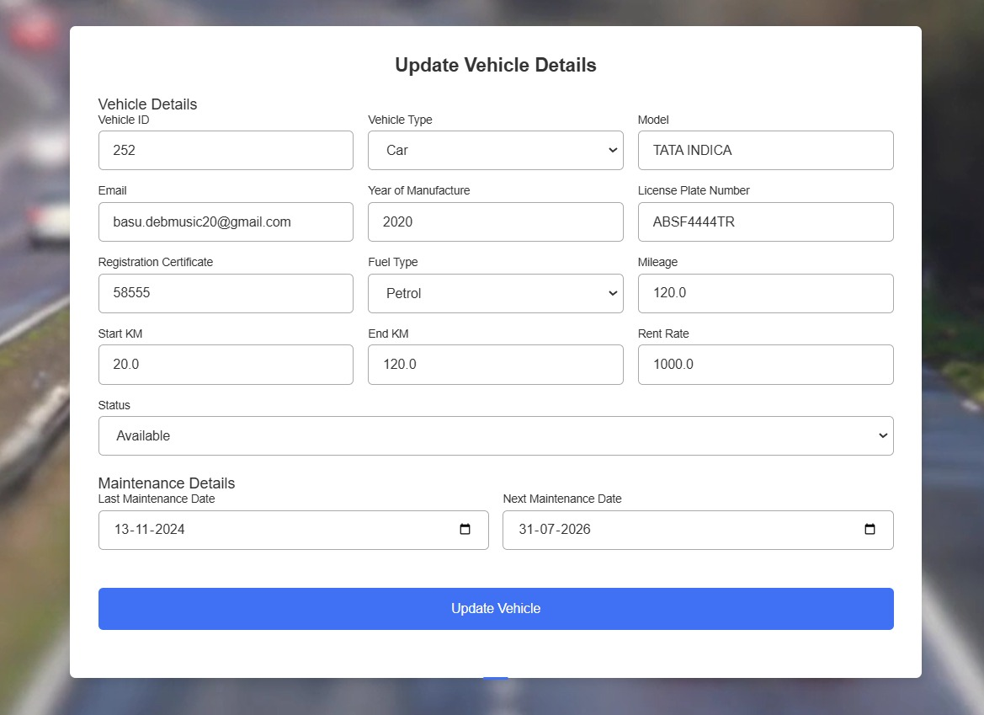
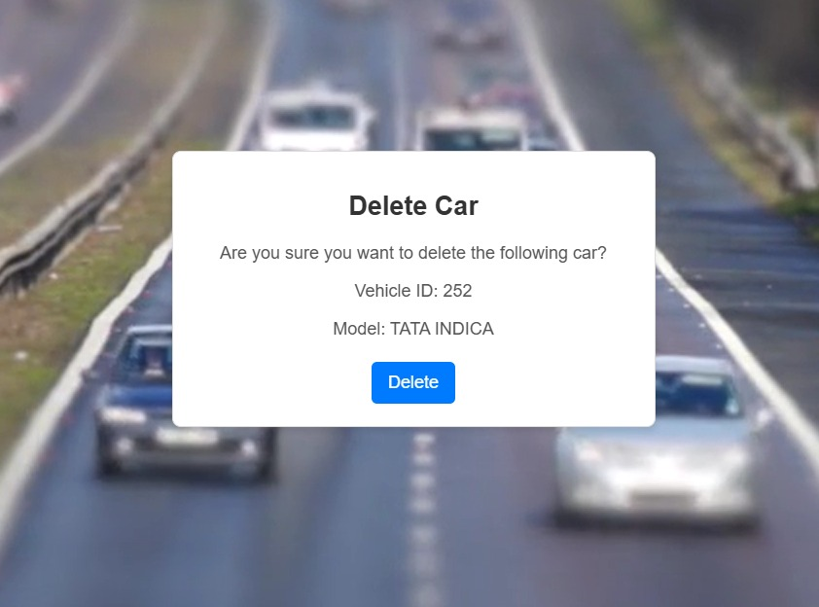
Update Vehicle Details:
Keep vehicle records accurate by updating specifications, availability, and maintenance history in real time.
Delete Car:
Maintain an up-to-date inventory by removing obsolete or retired vehicles from the system with ease.

Slide 15
Customer Management:
Secure customer access and automated management are now possible. This innovative module aims to optimize customer handling and improve efficiency. Simplify key processes, enhance resource management, and provide valuable insights through data-driven reports.
Features:
Registration & Login :
Secure login with persistent sessions.
2. Booking System:
Easy car booking and availability checks.
3. Loyalty Program :
Earn points, redeem discounts, and unlock rewards.
4. Customer Blacklisting :
Restrict problematic customers for security.

Slide 16
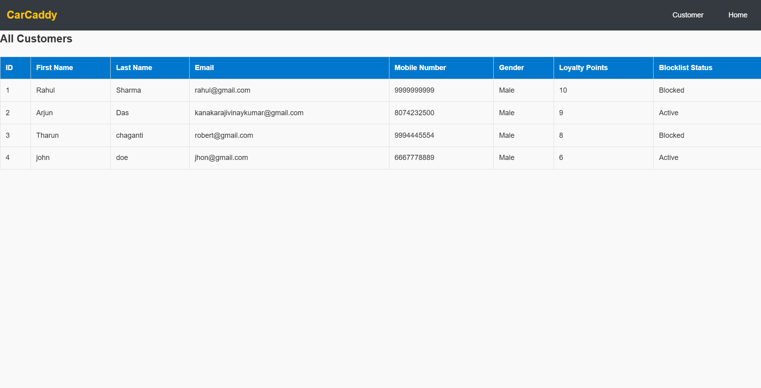
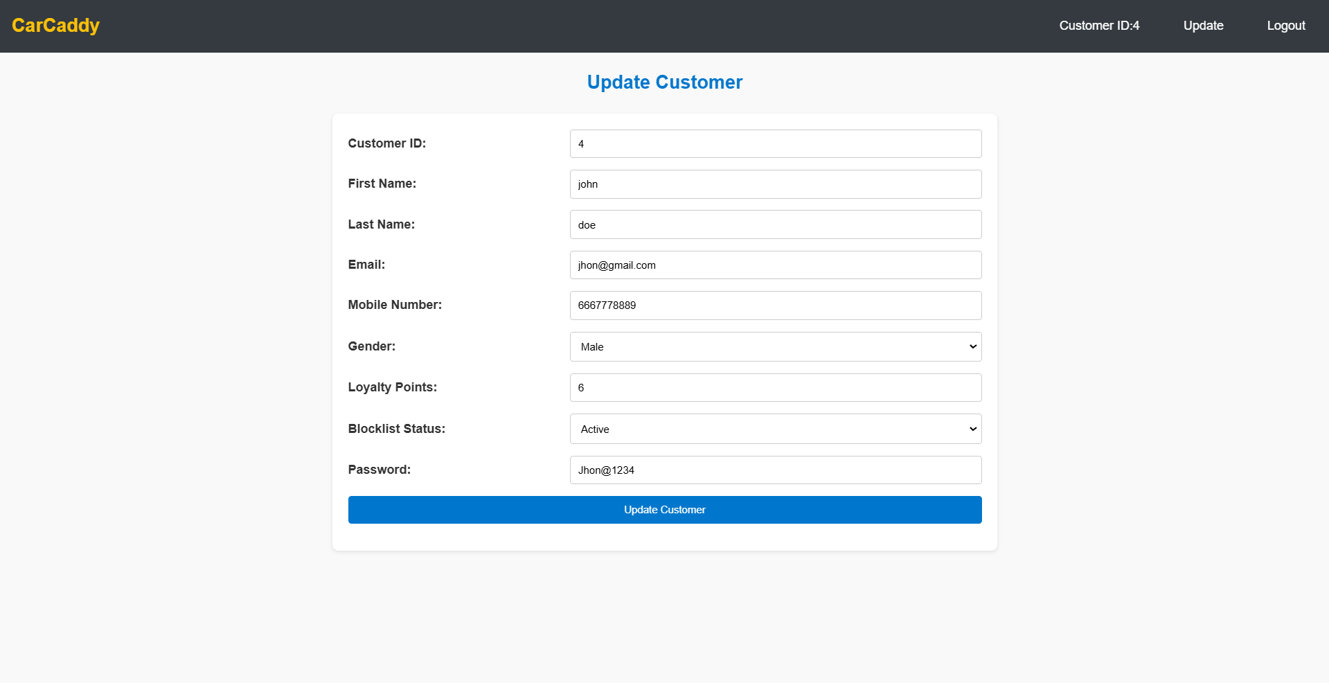
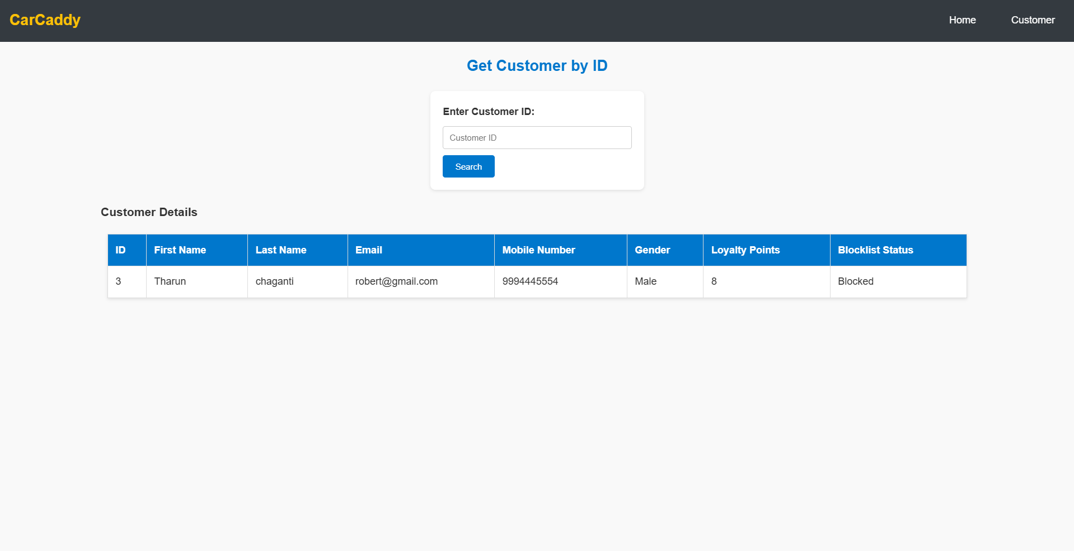
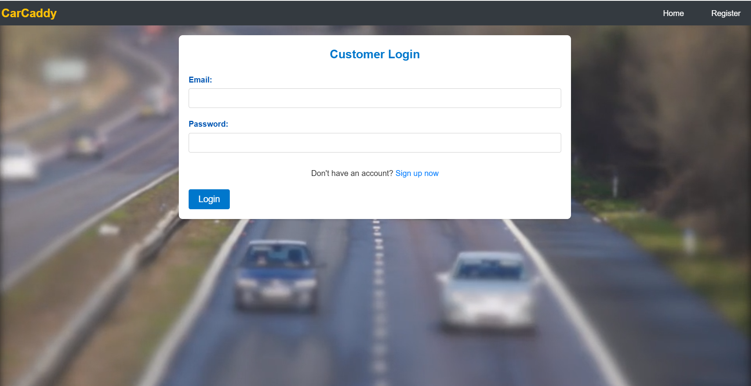
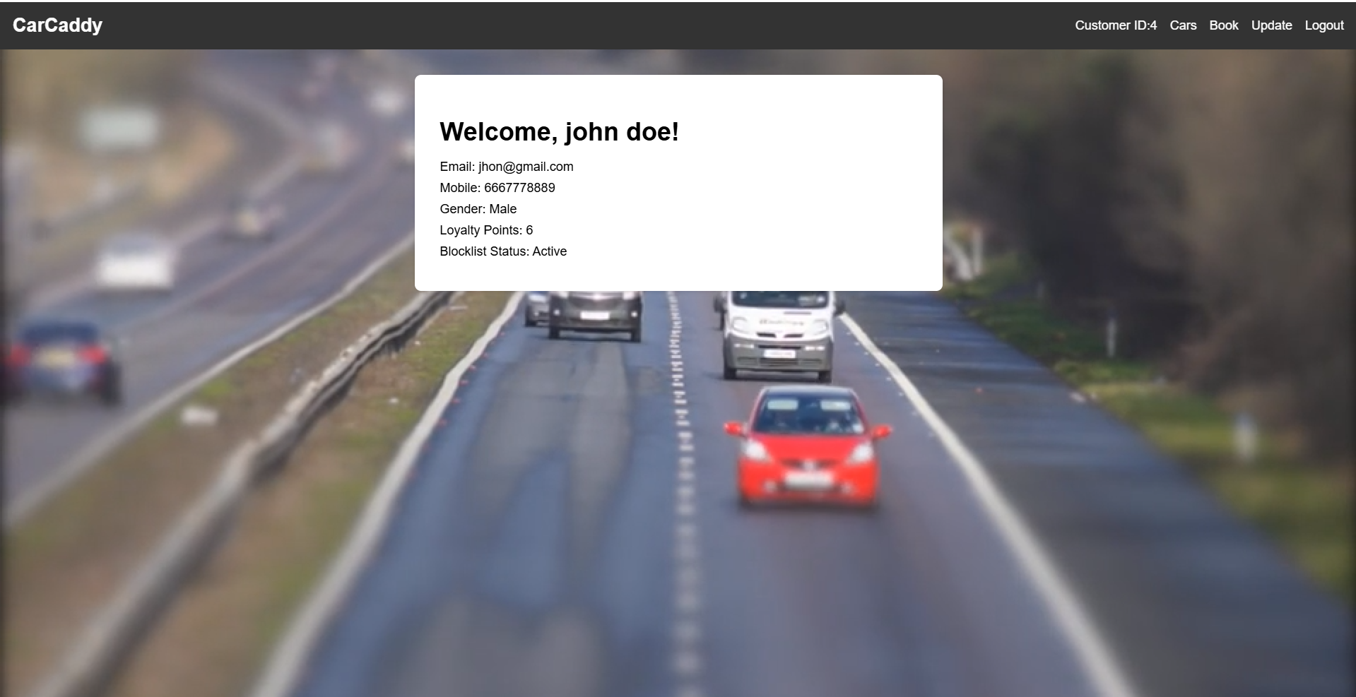
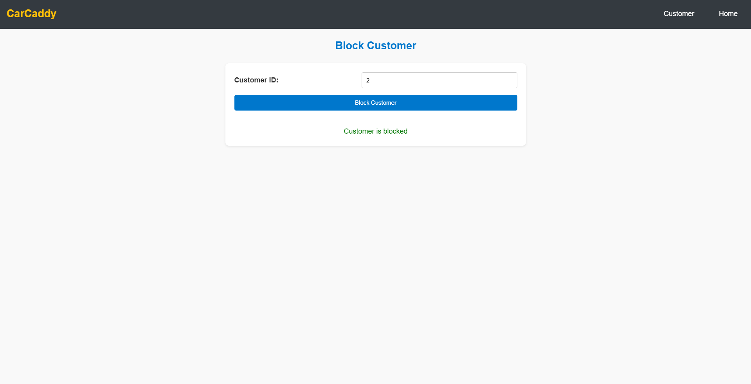
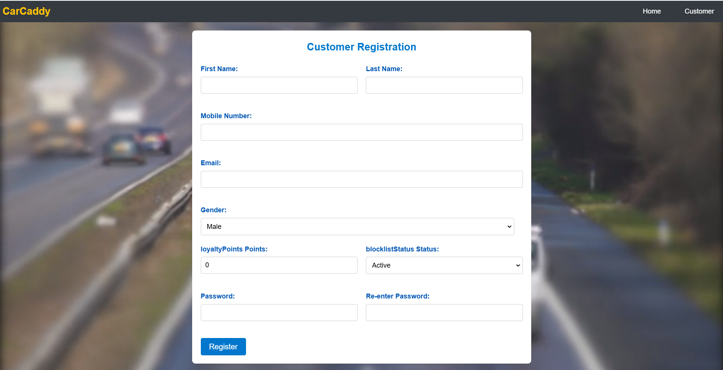
Customer Management

Slide 17
Rental Management:
CarCaddy's Rental Module comprehensively manages car rentals by integrating user profiles and inventory tracking, allowing multiple rentals per vehicle while maintaining accurate availability records.
The system empowers users to browse and book cars while receiving automated notifications, and enables administrators to handle inventory, approvals, and exceptions.
The module provides real-time updates to streamline operations and enhance customer satisfaction in the car rental ecosystem.

Slide 18
Key Features
One-to-many connections:
The Rental Module in CarCaddy integrates with user profiles, car inventory, and payment processing via one-to-many relationships. This design enables scalable, efficient data management, ensuring fast performance and minimal redundancy. A single car record links to multiple rentals, streamlining availability tracking and rental history.
Exceptional handling:
Robust error handling ensures stability by managing database errors, network outages, and invalid input with clear messages, maintaining a smooth user experience for customers and administrators.
Email notifications:
Automated email notifications ensure smooth communication by updating customers on bookings and administrators on issues, enhancing clarity and preventing misunderstandings.
Booking, updating, and cancellation:
The module offers a user-friendly interface for booking, updating, and canceling rentals, allowing customers to search for vehicles, select dates, and manage bookings with clear instructions and confirmations.

Slide 19
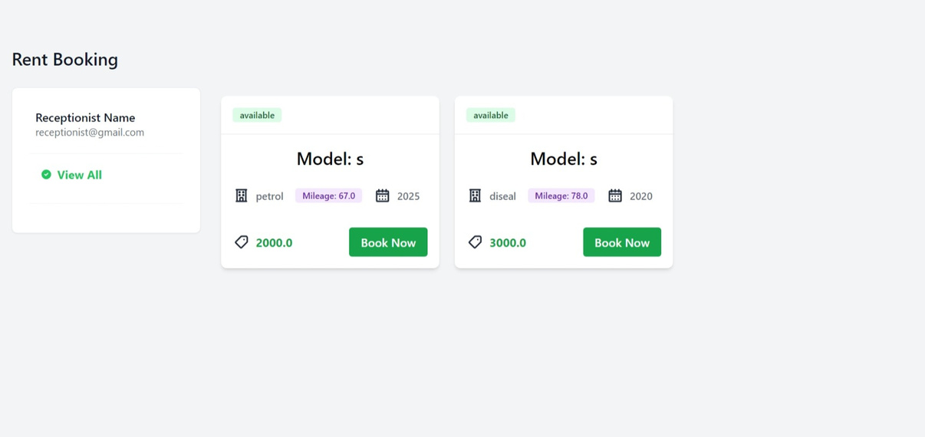
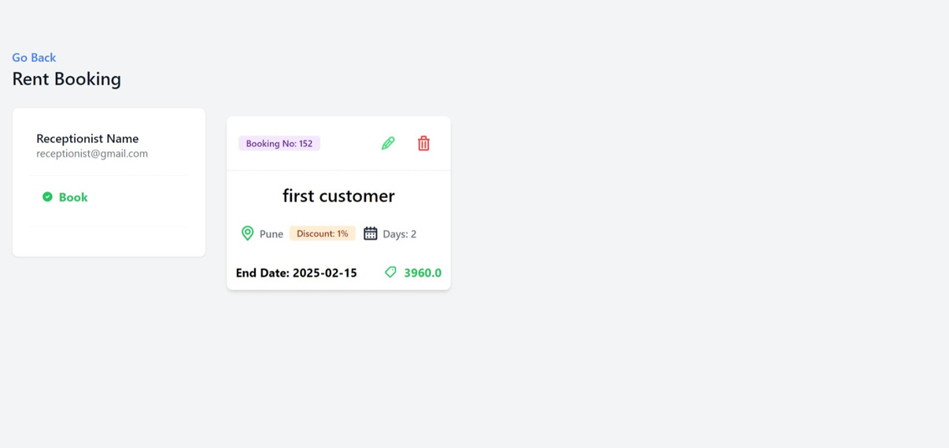
RENTAL MANAGEMENT

Slide 20
Maintenance Management:
🚖 The Car Maintenance Management System ensures efficient tracking and updates of car maintenance records. Admins can seamlessly add, update, and monitor maintenance details, reducing manual effort.
🚘Users stay informed through real-time email notifications about updates and completion reminders, ensuring they never miss a service update.
🚖 Additionally, daily reports help admins manage scheduled car deliveries efficiently, enhancing workflow and customer satisfaction.

Slide 21
Key Features:
Admin Controls
Allows efficient management of records and scheduling
Maintenance Record Management
Enables seamless tracking and updates of car maintenance details.
Email Notifications
Keeps users informed about updates and completion reminders.
Status Tracking
Provides real-time visibility into maintenance progress, enhancing efficiency and user experience.

Slide 22
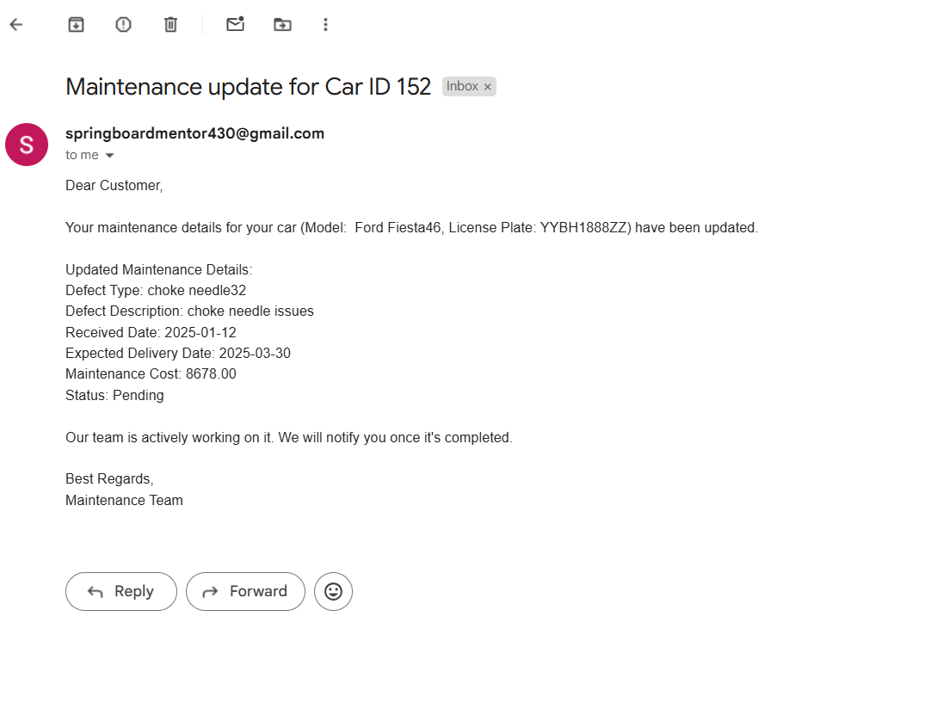
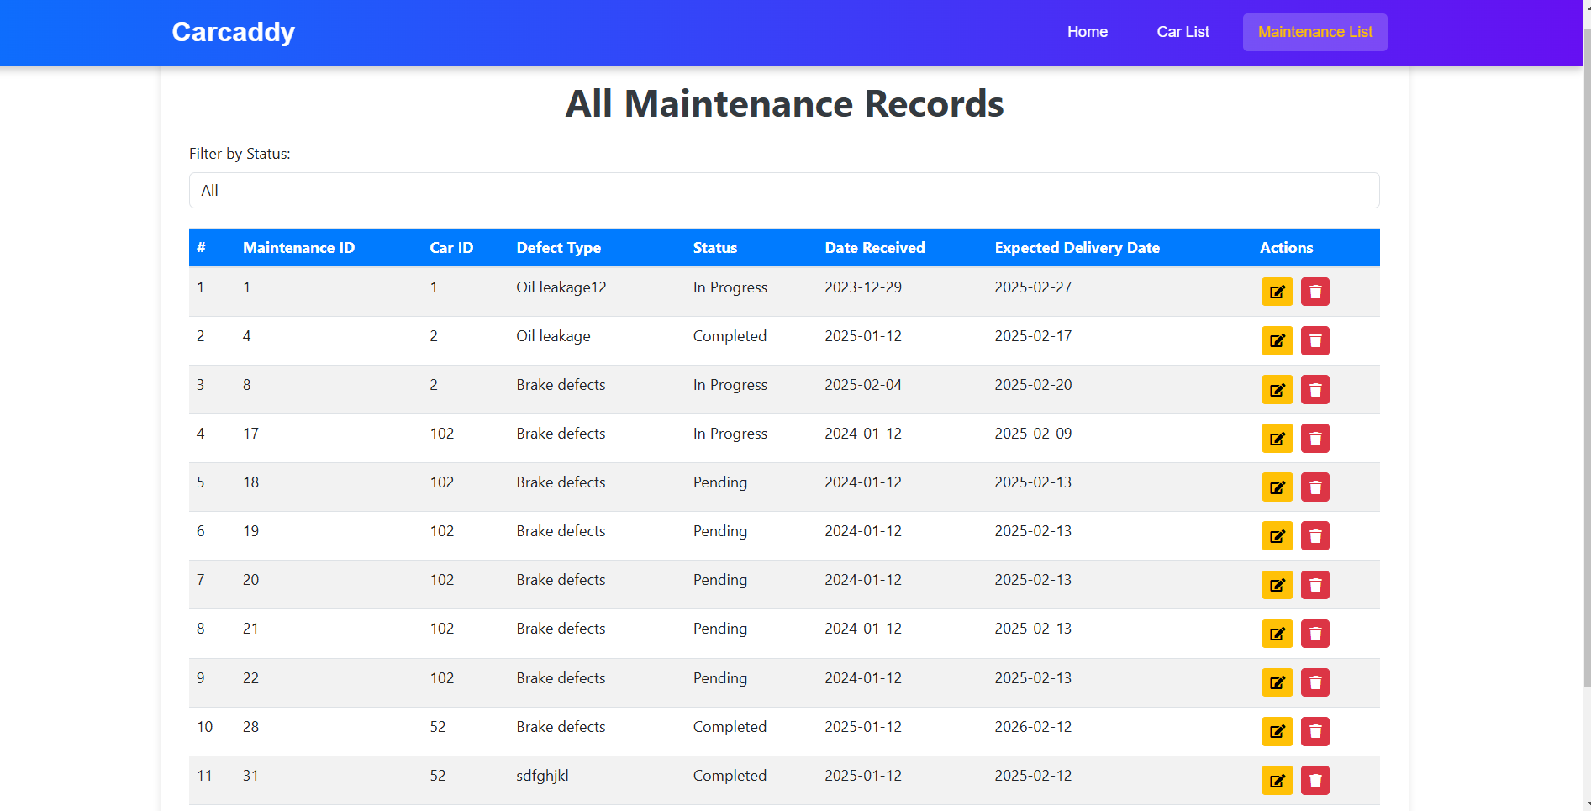
Maintenance Module

Slide 23
Future Scopes :
Enhanced ai and machine learning integration :
AI-powered chatbots for customer support and booking assistance.
Machine learning algorithms for dynamic pricing based on demand and seasonality.
Predictive maintenance alerts based on vehicle usage and wear.
Advanced exception handling :
Automated issue detection and resolution, reducing system downtimes.
Improved error logging and real-time alerts for critical failures.
AI-based anomaly detection to prevent fraudulent bookings or system abuse.
Seamless booking, updating & cancellation :
User-friendly mobile apps and web platforms for instant bookings.
Flexible rescheduling and cancellation policies with automated refunds.
Integration with digital wallets and crypto payments for seamless transactions
Improved email & sms notifications :
Real-time booking confirmation, reminders, and updates.
Notifications for vehicle availability, discounts, and offers.
Automatic alerts for maintenance, late returns, and policy updates.

Slide 24
Future Scopes :
IoT & GPS-based smart tracking :
Real-time vehicle tracking and geofencing for security.
Remote locking/unlocking of vehicles for keyless rentals.
Theft prevention mechanisms and route optimization for better fleet management.
Blockchain for secure transactions :
Smart contracts for automated agreement execution.
Decentralized and transparent transaction records for security.
Fraud detection and prevention through blockchain verification.
Cloud-based and scalable system :
Cloud hosting for global access and scalability.
Multi-platform access for customers and rental operators.
Disaster recovery mechanisms and data redundancy for reliability.
Integration with ride-sharing & public transport :
Partnership with ride-sharing services like Uber and Lyft.
Integration with public transport systems for multimodal travel planning.
Subscription-based car rental models for frequent users.

Slide 25
Technical challenges
Integration
Difficulty integrating different modules, such as Employment management and Car management
2. Database relationships
Handling complex database relationships, including one-to-many and many-to-one.
3. Exception Handling
Ensuring robust exception handling for login, booking, and employee management.
Project management challenges
1. Sprint deadlines
Managing sprint deadlines and task assignments effectively.
2. Team collaboration
Ensuring effective team collaboration as a scrum master.
3. Requirement changes
Handling last-minute requirement changes efficiently.

Slide 26
Solutions Implemented
Technical solutions
Project management solutions
Communication solutions
Structured database relationships
Global exception handling
Optimized API responses
Agile methodologies
Daily stand-ups
Prioritized tasks using a scrum board
Regular sync-up meetings
Documented challenges and solutions

Slide 27
Conclusion:
Car Rental Automation System effectively streamlines rental operations by integrating key modules .The system enhances efficiency through automated processes, including fare calculations, maintenance scheduling, and customer loyalty management. The structured development approach ensures smooth integration of backend and frontend components, making CARCADDY a scalable and reliable solution for modern car rental businesses.

Slide 28


